Slide 1
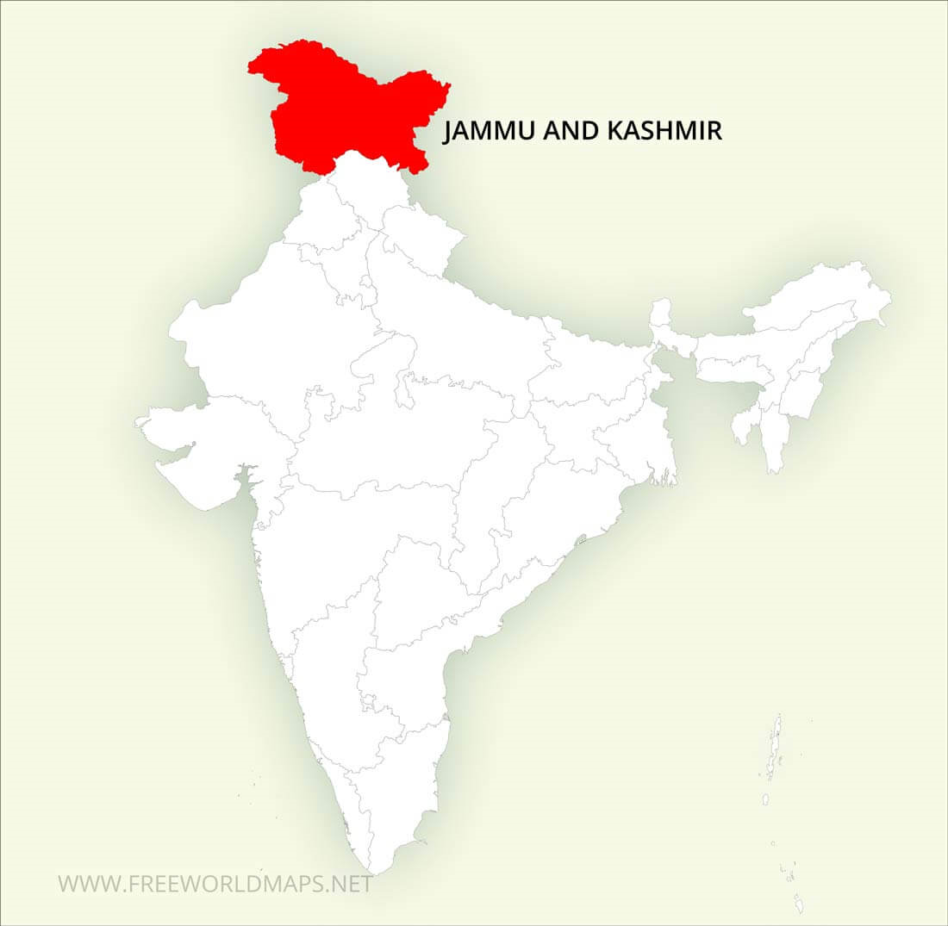
Jammu and Kashmir

Slide 2
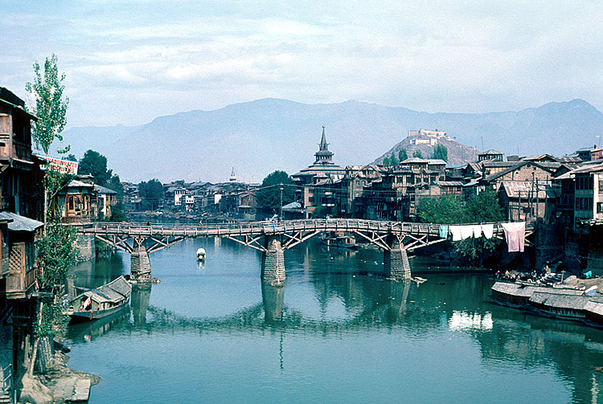
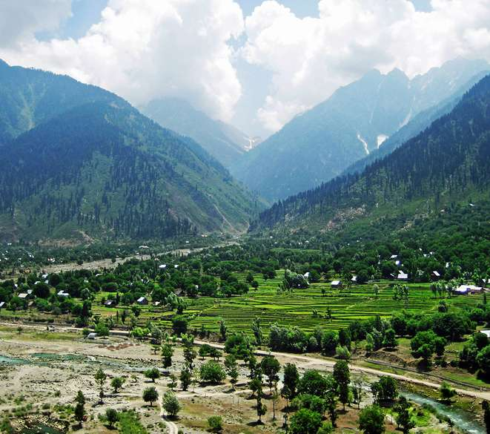
Capital of Jammu and Kashmir
SHRINAGAR
JAMMU
Jammu(winter),
Srinagar(summer)

Slide 3
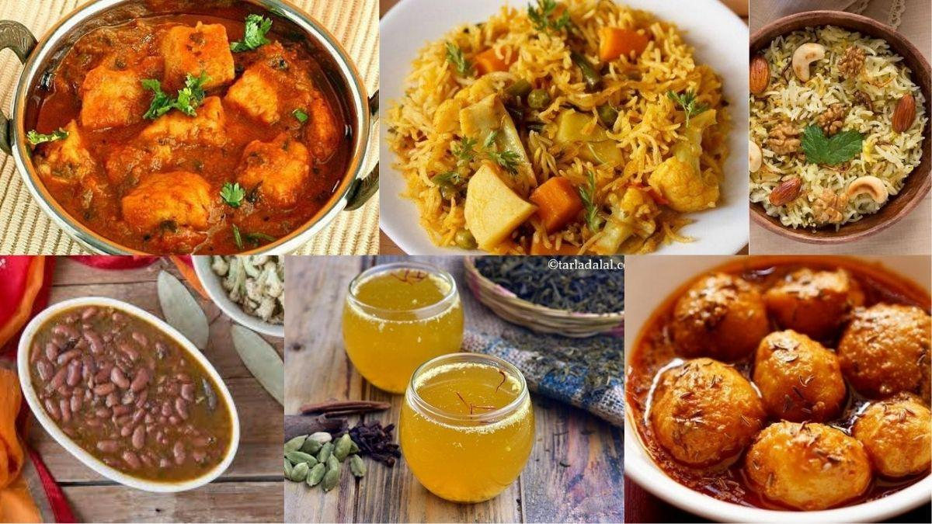
Special diet and delicacies
Rista
Dum Aloo
Goshtaba
Rogan Josh
Yakhni Pulao
Kashmiri Naan
Rajma Chawal
Lotus Root Curry
Kahwa

Slide 4
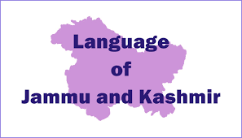
5 official languages of
Jammu and Kashmir-
Kashmiri
Dogri
Urdu
English
Hindi

Slide 5
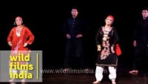
Music and Dance forms
Following are the trends of music of Jammu and Kashmir:
Chakri
Ladishah
Following are the important dance forms of Jammu and Kashmir:
Ruf Dance
Buchha Nagma Dance
Dandaras Dance

Slide 6
Historical places in Jammu and Kashmir

Slide 7
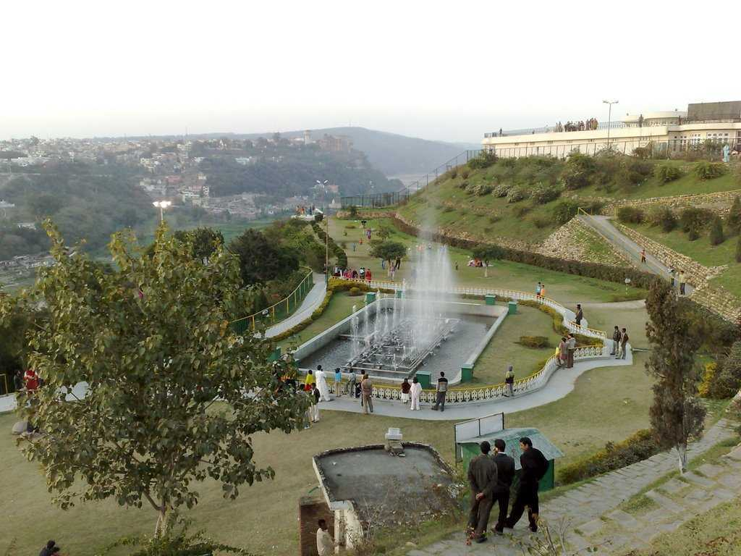
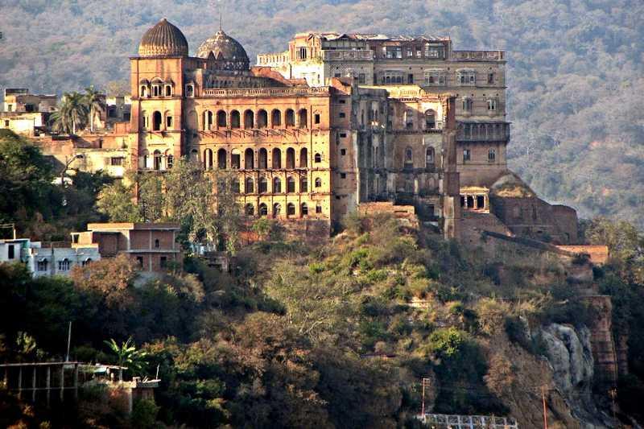
THE BAHU FORT
The Bahu Fort surely stand to be a significant contributing facto. Located only 5 km from the central part of the city, the Bahu Fort stands tall and sturdy on the left bank of the Tawi River. Raja Bahucholan constructed this magnificent fort over 3000 years ago, making it one of the oldest monument in the city. The Dogra rulers then made some restorations and renovations to the fort and extended its reach.
The architecture of the palace is an elaborate blend of Rajasthani, Mughal and European influences.
One of its most spectacular segment, The Shesh Mahal or The Pink Hall houses the Dogra Art Museum which has several miniature paintings and Emperor Shah Jahan's golden bow and arrow, among other interesting thing.
MUBARAK MANDI PALACE

Slide 8
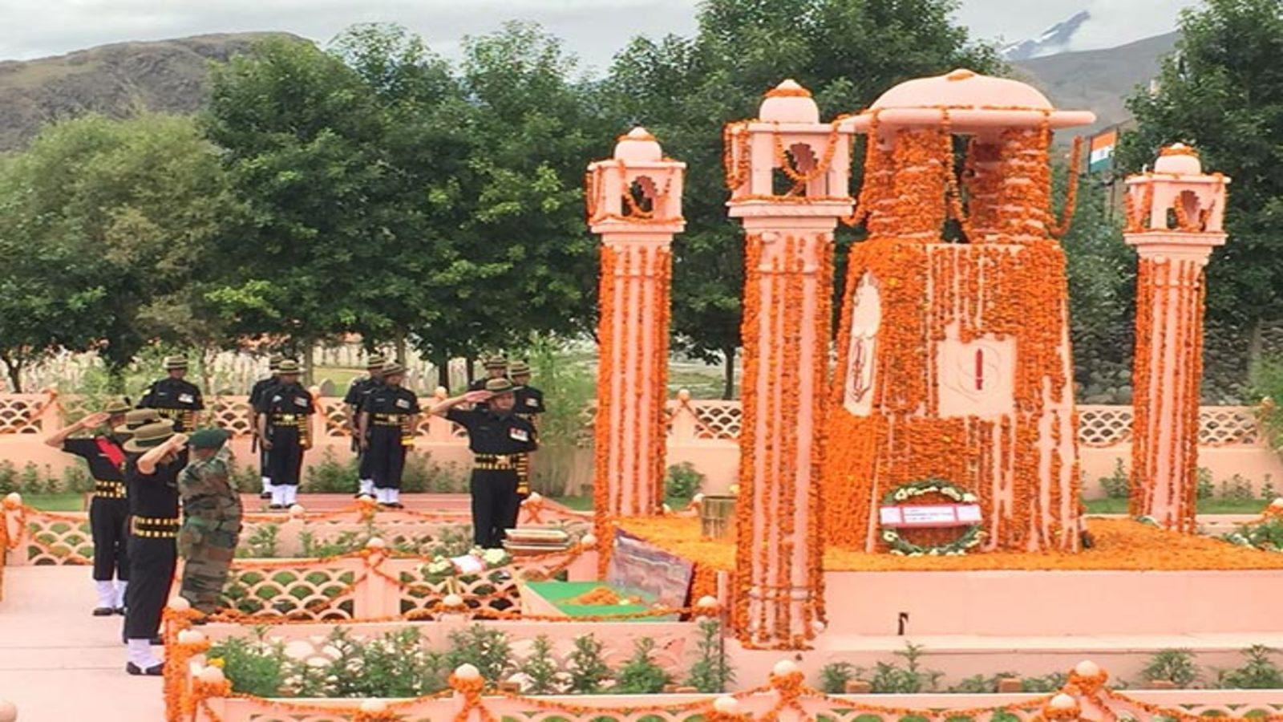
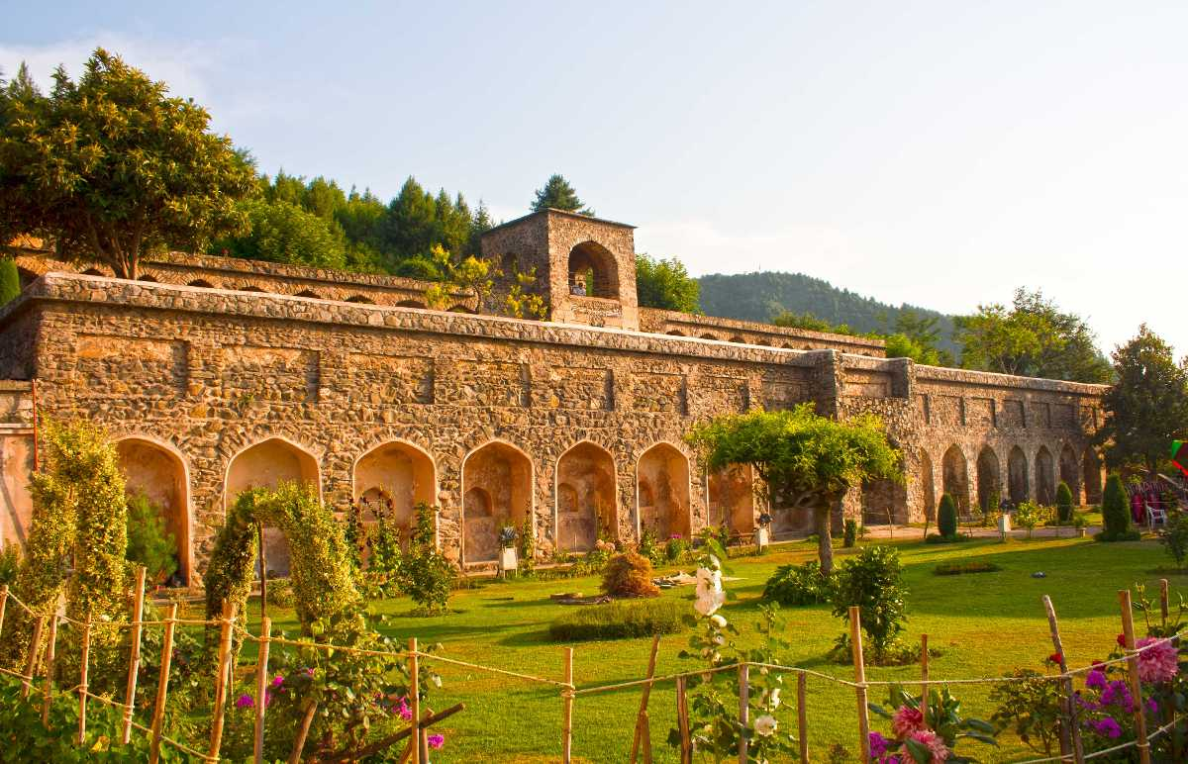
DRAS WAR MEMORIAL
Located in Kargil, the Dras War Memorial is built by the Indian Army in memory of the soldiers and officers who lost their lives during the Kargil war in 1999. Also known as Vijaypath, it is built of pink sandstone and has an epitaph dedicated to the valiant soldiers. The main highlight here is the pink sandstone wall engraved with the names of the soldiers who died fighting for the country.
Pari Mahal is a seven-terraced garden located above the beautiful Chashme Shahi Gardens near Srinagar. Also called the abode of fairies or the home of angels, the historical monument sits on top of the Zabarwan range overlooking Srinagar and the Dal Lake. The main attraction is the numerous colourful flowers and exotic fruit plantations.
PARI MAHAL

Slide 9
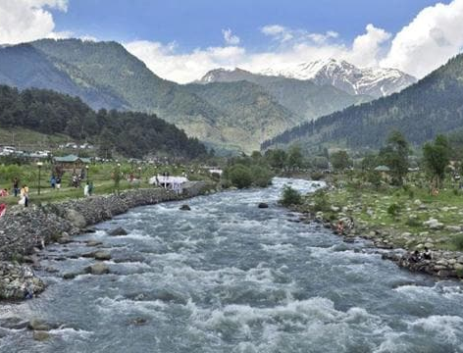
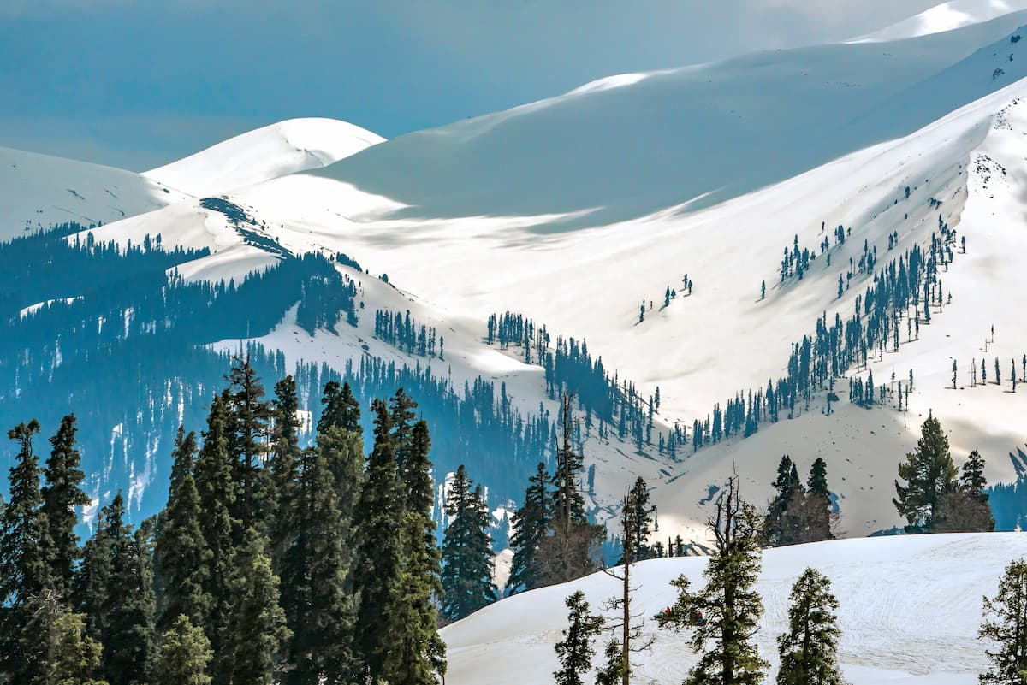
Rivers & Mountains
Rivers-
Jhelum
Chenab
Indus
Ravi
Mountains-
Karakoram
Zanskar Range
Nun Kun Range
Nanga Parba
Apharwat Peak

Slide 10
National Parks and Sanctuaries
Wildlife Sanctuaries of J&K
Thajwas - Baltal Wildlife Sanctuary.
Gulmarg Wildlife Sanctuary.
Overa Aru Wildlife Sanctuary.
Rajparian Wildlife Sanctuary.
National Parks
Dachigam National Park
Hemis National Park
City Forest National Park
Kishtwar National Park
Kazinag National Park

Slide 11
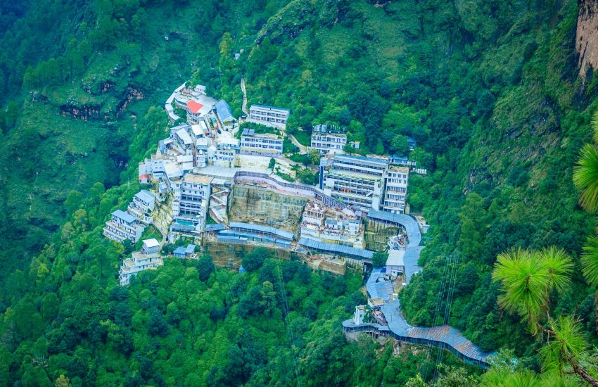
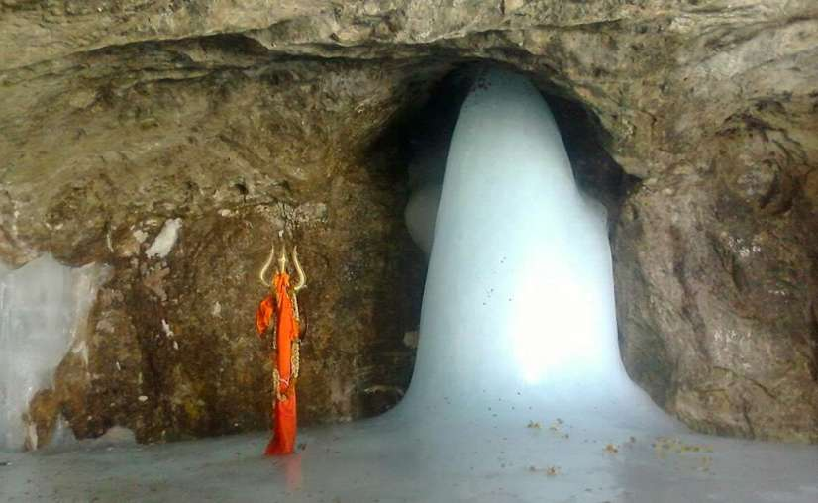
Famous Religious Places
Vaishno Devi
Amarnath

Slide 12
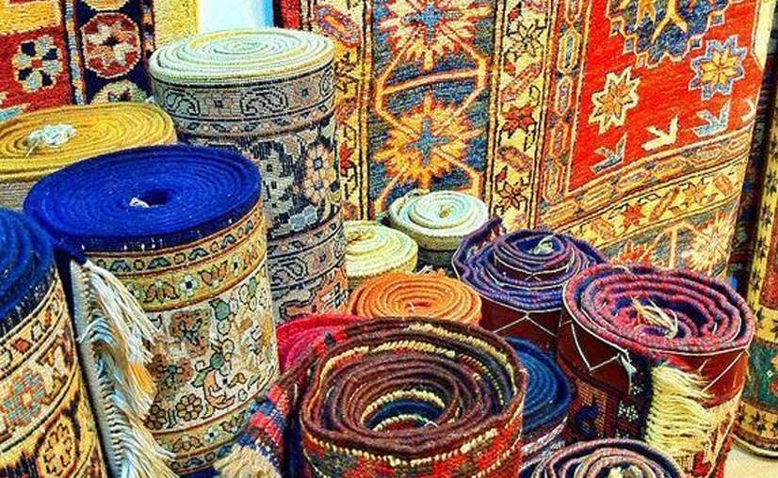
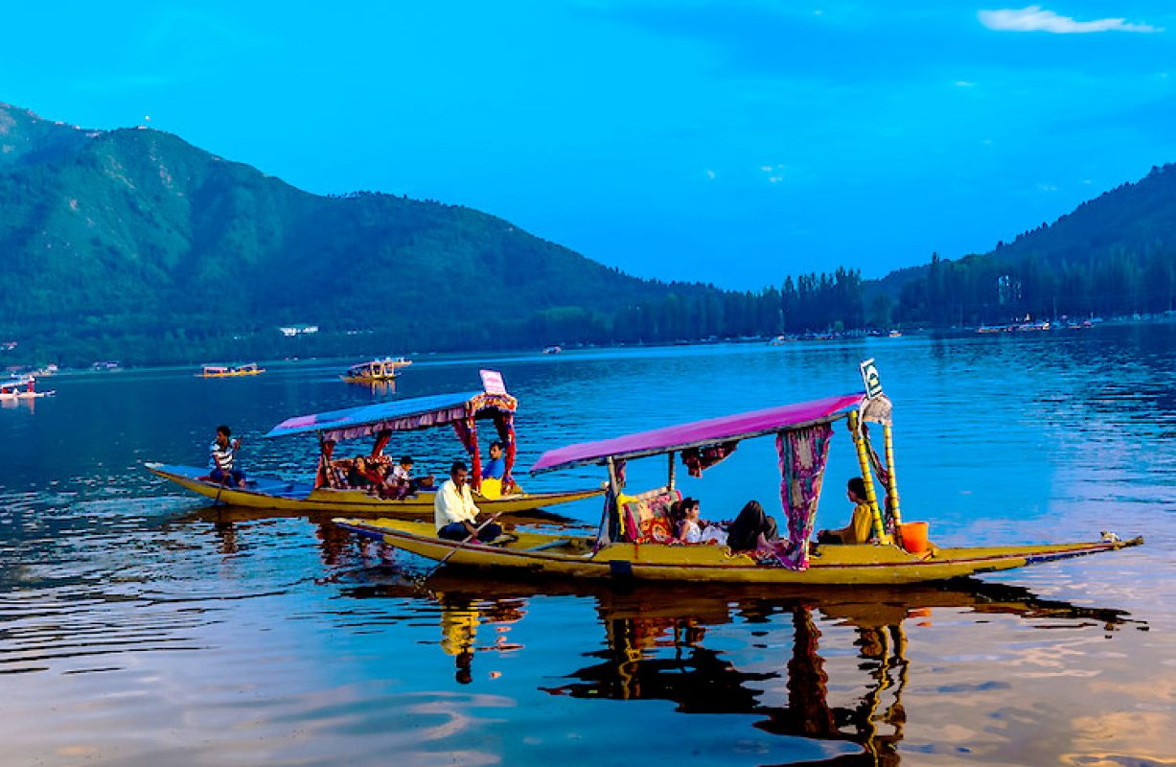
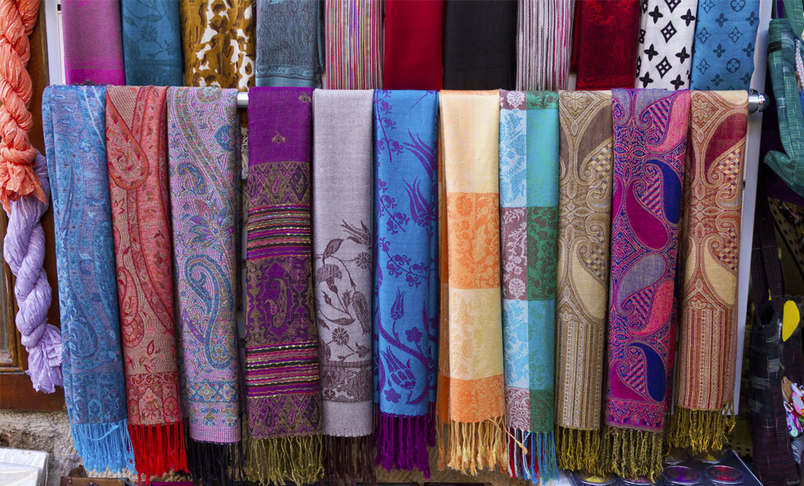
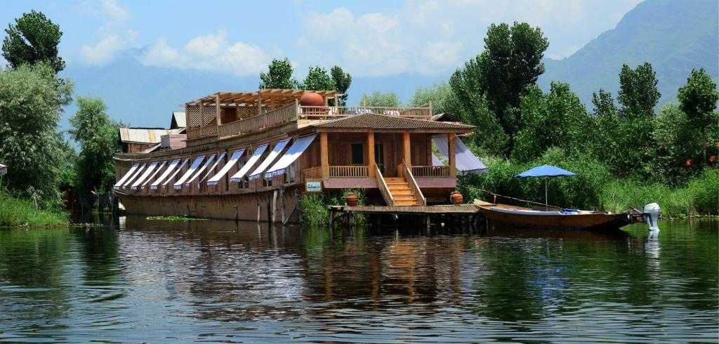
Carpets
Dul Lake
House Boat
Shawls

Slide 13


